Slide 1

Scalability and Monitoring
Tejas Hegde
AIOps Engineer at HPE

Slide 2
Agenda
Scalability
Microservices
Vertical Scaling
Horizontal Scaling
Hands-on Scalability
Monitoring and Logging
Monitoring
Hands-on Monitoring
Logging

Slide 3
Scalability
Scalability is the term we use to describe a system’s ability to cope with increased load[1].
There are two ways to address scalability concerns[2]:
Vertical scaling(scale up/down): increase the computing power of a single node.
Horizontal scaling(scale out/in): increase the number of nodes.
Horizontal scaling is used for most kinds of general applications including web applications and supercomputers. However, it is advantageous to apply vertical scaling since it is less complex in terms of management. Moreover, massively parallel applications such as Graphics don’t work well with multiple nodes. Adding computing power to a node within a cluster may improve results, especially in case of database engines.

Slide 4
Microservices
An architecture or an architectural pattern is a reference/template that can be applied to commonly occurring types of software architectural problems.
There are various types of architectures: monolithic, microservices, space based, n-tier etc. Each type of architecture has its own merits and de-merits. No single architecture is applicable for all software problems.
Microservices is a specific case of component based architecture: where the problem can be decomposed into a set of independent applications that must coordinate themselves through some kind of distributed messaging. As such, the management and testing of such distributed applications may be tougher compared to monolithic applications. However, it is easier to maintain and scale these independent parts.

Slide 5
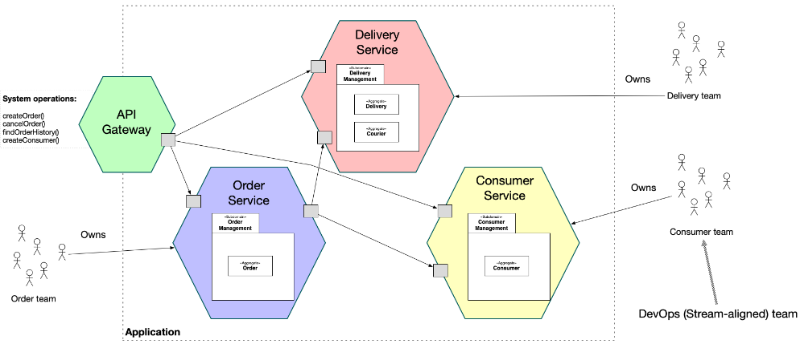
Microservices example
A Fictious E-Commerce Application(credits; microservices.io)

Slide 6
Container Scalability: Vertical Scaling
As mentioned earlier, vertical scaling is simply a matter of assigning resources. However, by default, Docker containers have unlimited access to the host's physical memory and CPU. Unless carefully controlled, a misbehaving container can consume more resources than planned and cause performance bottlenecks[3].
It is very simple to assign resources to a container using docker run[4]:
docker run --cpus 1 --memory 1g <image>
This assigns a limit of 1 CPU and 1GB memory to the container.

Slide 7
Container Scalability: Horizontal Scaling
While containers simplify the management of software, the complexity of distributed systems still applies to containers. This applies in the context of horizontal scaling.
A pure docker approach towards horizontal scaling would require docker swarm. However, docker swarm is ideal for smaller workloads. Larger ones can be dealt with using Kubernetes[5].
In the hands-on, Kubernetes is used. Kubernetes CLI is used to manually scale the number of containers. However, autoscaling can also be used[6].
We can also assign CPU and memory to each container set in the Kubernetes configuration file[7].

Slide 8
Hands-on: Scalability
For the hands-on, we make use of “example-voting-app” repository of “docker samples”, official Docker Samples produced by docker.
URL: TXH2020/example-voting-app: Example distributed app composed of multiple containers for Docker, Compose, Swarm, and Kubernetes (github.com)
It is a web application based on microservices architecture.
For running the hands on, the following software tools are required to be installed on a Linux VM with at least 2CPUs, 2GB free memory, 20GB storage space available and a good internet connection:
Git
Minikube
Alternatively, Play With Kubernetes Playground may be used. This requires a GitHub or Docker Hub account.

Slide 9
Monitoring and Logging
Monitoring and Logging are standard industry practices for the purposes of debugging and performance optimization.
Monitoring is the process of collecting and visualizing metrics collected from the monitored applications. Logging is the process of producing messages with timestamps that help verify the functioning of an application.
Almost all software frameworks and programming languages have built-in support for logging. However, the process of log collection and processing may require the use of external libraries.
Similarly, metric collection and visualization may require external libraries.
Example Log(from kubernetes.io): Example metric: counter
1025 00:15:15.525108 1 httplog.go:79] GET /api/v1/namespaces/kube-system/pods/metrics-server-v0.3.1-57c75779f-9p8wg: (1.512ms) 200 [pod_nanny/v0.0.0 (linux/amd64) kubernetes/$Format 10.56.1.19:51756]

Slide 10
Monitoring
There are various solutions in the market for the purpose of monitoring. However, many companies tend to prefer open-source solutions, since they are free and customizable.
Prometheus along with Grafana is a very popular combination for monitoring. Prometheus is an observability platform while Grafana is an analytics and visualization platform. While Prometheus mainly deals with metric collection, Grafana can be used to visualize those metrics in the form of plots. Both are open-source.
Both of them can be used by directly installing them on the system or by using their docker images.
Collection of metrics/production of web plots requires intermediate servers which collect values from clients. Hence the workflow of Prometheus-Grafana is as follows:
Start Prometheus server -> Start Grafana Server -> Start Prometheus Client -> Connect Grafana to Prometheus Data Source -> Visualize in Grafana.

Slide 11
Hands-on: Monitoring
For the hands-on, we make use of a python project described in dev.to.
URL: Setup Grafana with Prometheus for Python projects using Docker - DEV Community
It is a simple python script that invokes prometheus client.
For running the hands on, the following software tools are required to be installed on a Linux VM with at least 2CPUs, 2GB free memory, 20GB storage space available and a good internet connection:
Git
Docker
Alternatively, Play With Docker Playground may be used. This requires a GitHub or Docker Hub account.

Slide 12
Logging
There must be logging statements in the application code. It should carry meaningful information about the process/code that produces the logs.
Most logging libraries contain log levels as follows: DEBUG, INFO, WARNING, ERROR. DEBUG is used for printing detailed information, useful while diagnosing problems. INFO is used for verifying normal operations. WARNING is used to show problems that do not cause the application to stop, but may signify performance issues or potential errors. Finally, ERROR is used to show that an abnormal event has occurred due to which the application might not have performed a function.
When an application is run directly, it will produce logs to a file on the machine’s filesystem. However, when using docker containers, volumes must be used to make sure that logs are saved on the machine’s filesystem.

Slide 13
Docker Logging
docker logs <container_name>: This command prints all information that is printed onto STDOUT/STDERR by the application. This may include logging statements that print onto STDOUT. However, log files are not obtained.
By default, docker uses json-file logging driver. This means that it writes JSON logs to the container’s log file, which can be found in the /var/lib/docker/<container_id> directory. This format is inefficient compared to the local file driver, which performs log rotation which saves disk-space.
To change the logging behavior for all containers(except existing ones), change the /etc/docker/daemon.json file. We can also change the logging behavior for an individual container using --log-driver option. We can further control the behavior of the log driver using --log-opts.
There are several logging drivers such as syslog, journald, awslogs, gcplogs etc.

Slide 14
References
Kleppmann, M. (2017). Designing data-intensive applications: The big ideas behind reliable, scalable, and maintainable systems. " O'Reilly Media, Inc.".
Michael, M., Moreira, J. E., Shiloach, D., & Wisniewski, R. W. (2007, March). Scale-up x scale-out: A case study using nutch/lucene. In 2007 IEEE International Parallel and Distributed Processing Symposium (pp. 1-8). IEEE.
Marko Aleksic. (December 2023). How to Limit Docker Memory and CPU Usage. phoenixnap.com. How to Limit Docker Memory and CPU Usage | phoenixNAP KB
Anshul Chouhan. (May 2024). How to Use Docker Images For Scaling Applications? geeksforgeeks.com. How to Use Docker Images For Scaling Applications? – GeeksforGeeks
Chris Rosen. (June 2022). Docker Swarm vs. Kubernetes: A comparison. ibm.com. Docker Swarm vs. Kubernetes: What’s the Difference?| IBM
kubernetes.io. (n.d.). HorizontalPodAutoscaler Walkthrough. HorizontalPodAutoscaler Walkthrough | Kubernetes
kubernetes.io. (n.d.). HorizontalPodAutoscaler Walkthrough. Assign Memory Resources to Containers and Pods | Kubernetes

